Slide 1
Cold War Conflicts
Chapter 18

Slide 2
Origins of the Cold War

Slide 3
COLD WAR
U. S. is in
fear of Communist Aggression
Spread of Communist ideology spreading

Slide 4
COLD WAR
Soviets feared “Capitalist encirclement”

Slide 5
COLD WAR
Climate of mutual distrust

Slide 6
The United Nations
50 nations met in San Francisco in April of 1945 and established a new peacekeeping body.
UN Today- Security Council (15 members, 5 permanent, 10 non-permanent) China, France, Russia, UK, and US
Everyone else General Assembly, 193 Countries
Based in NYC

Slide 7
Potsdam
New Big Three
Soviet Union- Stalin
US- Truman
UK- Attlee (Churchill’s party lost)
At Yalta, Stalin promised free elections in Poland
At Potsdam, Stalin refused to allow free elections

Slide 8
Potsdam
Germany divided into four zones (Soviet, France, US, GB)
Only take reparations from your own zone
US wanted to spread Democracy, free trade and sell to European markets.
Soviet Union suffered heavy losses during WWII. 20 million soldiers and civilians.
Soviet Union felt justified in claiming Eastern Europe.
Stalin did not remove troops from Eastern Europe and he instilled communist governments in Albania, Bulgaria, Czechoslovakia, Hungary, Romania, and Poland. These countries were known as satellite nations

Slide 10
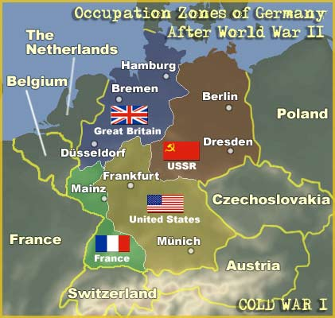

Slide 11
Germany, and the city of Berlin, became flashpoints in the Cold War.
After the war, Germany was divided into four zones.
The zones controlled by the United States, Britain, and France were combined to form West Germany.
The Soviet zone became East Germany.

Slide 12
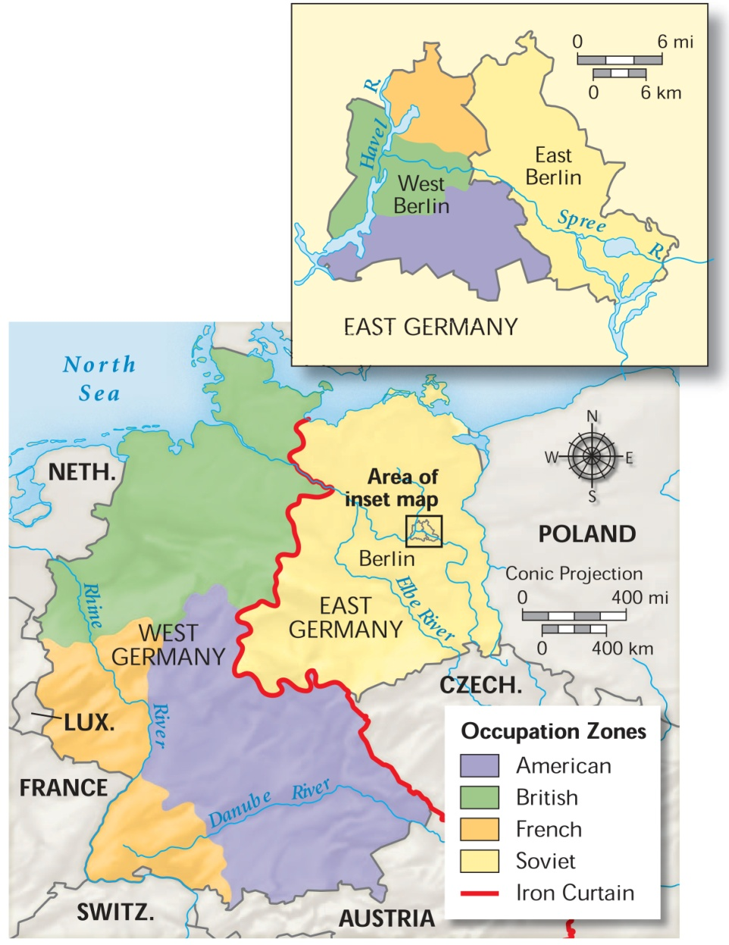
Berlin lay inside East Germany. However, it was also divided.

Slide 13
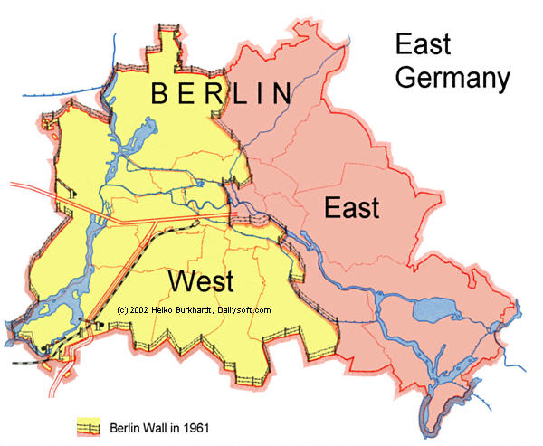

Slide 14
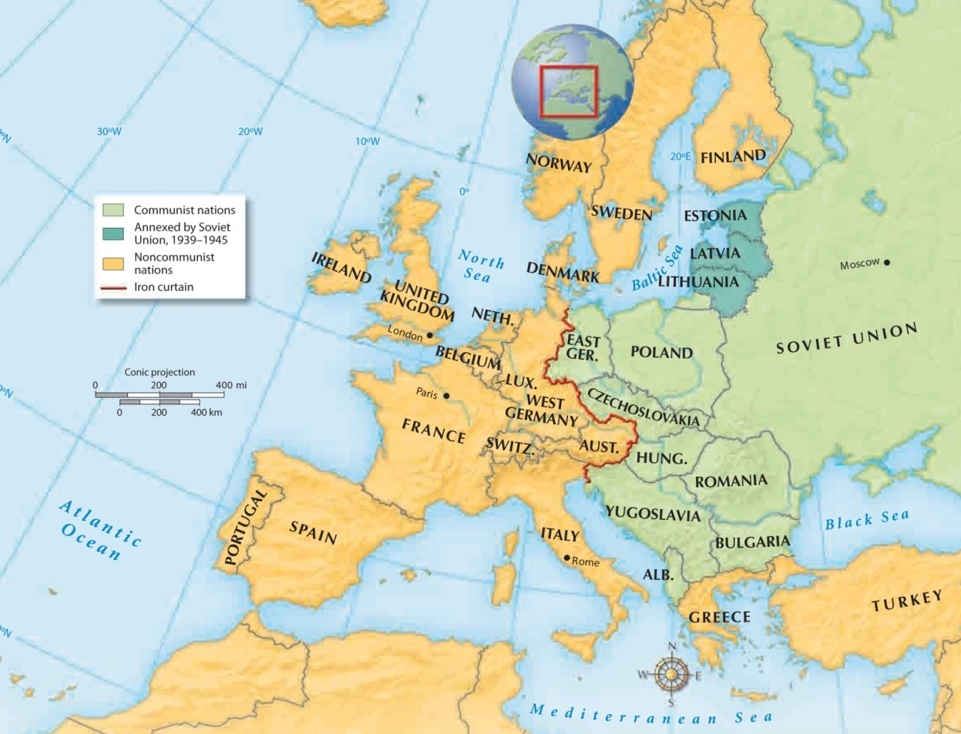
Cold War Europe, 1949

Slide 15
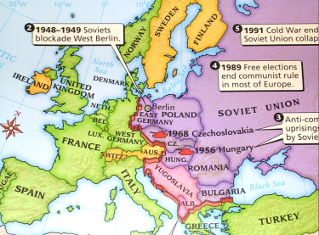

Slide 16
Containment
February 1946 George Kennan, an American diplomat in Moscow proposed the policy of containment.
Containment US policy during the Cold War. Guided all US Presidents during Cold War
Taking measures to prevent an extension of communist rule to other countries
Communism is okay where it already is, just don’t let it spread

Slide 17
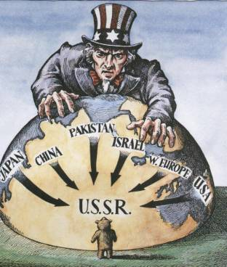
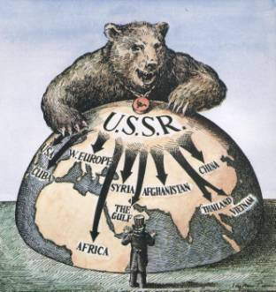

Slide 18
Containment
West Europe- Democratic
East Europe- Communist
Winston Churchill coined the phrase “Iron Curtain”
Describe the division of Europe.

Slide 19
“Iron curtain.”
Cold War Europe, 1949

Slide 20
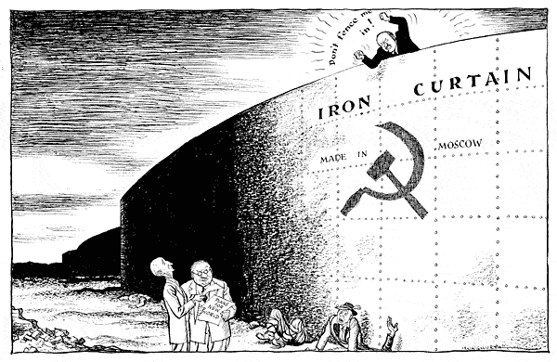

Slide 21
COLD WAR
Cold War between US and Soviet Union
Conflicting aims, ideas, philosophy, and goals
No direct confrontation between Soviet Union and US

Slide 22
With the Truman Doctrine, the United States promised to support nations struggling against communist movements.
Greece and Turkey were fighting communist movements. Money was sent to these countries to provide aid to people who needed it.
400 Million in economic and military aid for Greece Turkey to fight off Communism.
“It must be the policy of the United States to support free peoples who are resisting attempted subjugation by armed minorities or by outside pressures.”

Slide 23
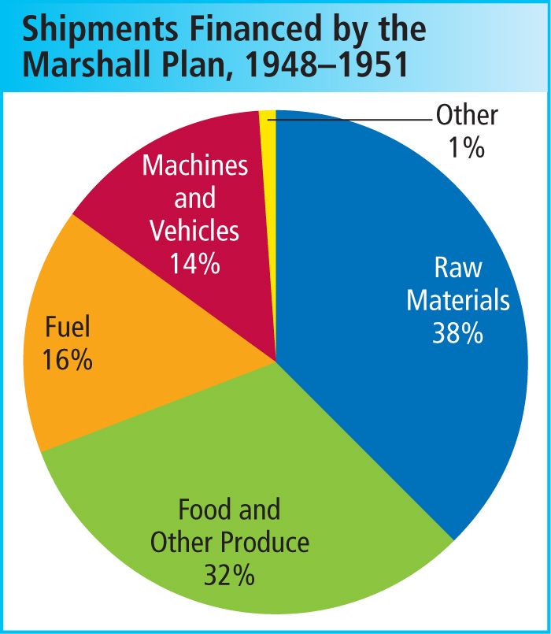
The United States also sent about $13 billion over 4 years to 16 Western European countries under the Marshall Plan.
The money provided food, fuel, and raw materials to help rebuild war-torn cities and towns.
The good relationships the aid created helped the goals of the containment policy.

Slide 24
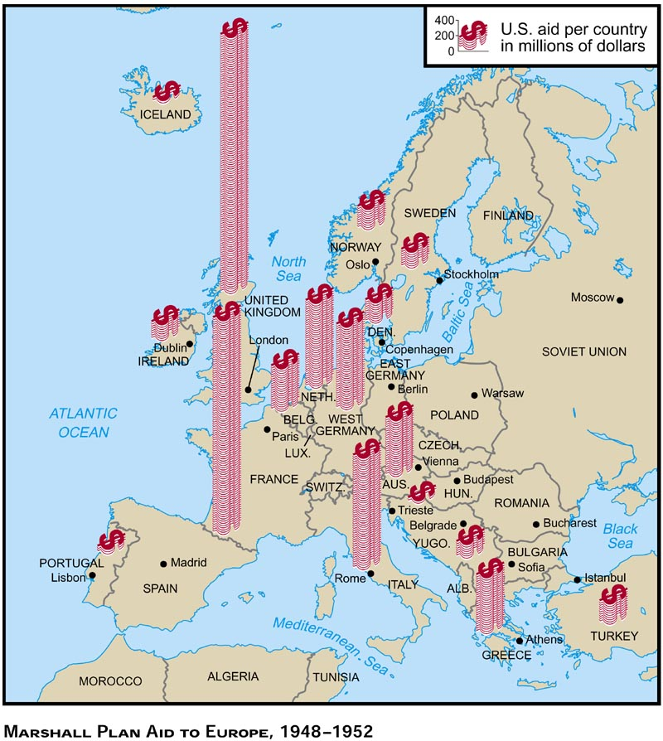
Great Britain | 2,826,000,000
France | 2,445,000,000
Italy | 1,316,000,000
West Germany | 1,297,000,000
Holland | 877,000,000
Austria | 561,000,000
Belgium/Lux | 547,000,000
Denmark | 257,000,000
Norway | 237,000,000
Turkey | 153,000,000
Ireland | 146,000,000
Sweden | 119,000,000
Portugal | 51,000,000
Yugoslavia | 33,000,000
Iceland | 29,000,000

Slide 25
Struggle over Germany
No Soviet guarantee to free access by roads or railway to West Berlin
In an attempt to peacefully take the city, Stalin closed all highways and rail routes into West Berlin.
Cut city off. No food or fuel
2.1 million people in West Berlin

Slide 26
Berlin Airlift
American and British planes went above the blockade which was known as the Berlin Airlift.
327 days
277,000 flights
2.3 million tons of supply (food, fuel, medicine)
Nonstop every few minutes a plane landed and took off
May 1949 the Soviets lifted the blockade

Slide 27
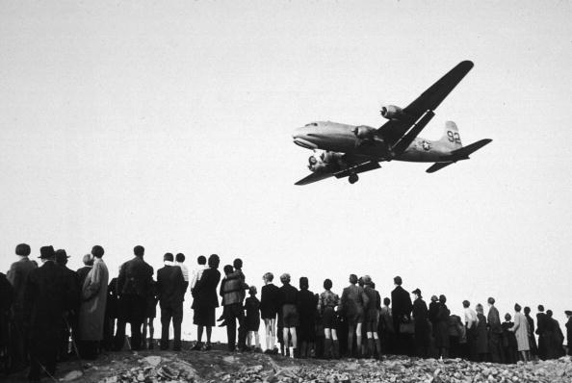

Slide 28
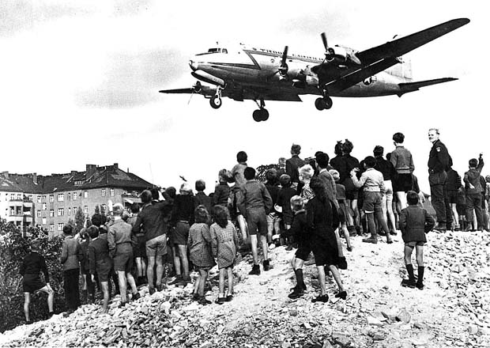

Slide 29
NATO
May 1949 –West Germany becomes a new country
Federal Republic of Germany aka West Germany
The Soviets responded by creating the German Democratic Republic aka East Germany
Fear of Soviet aggression Belgium, Denmark, France, GB, Iceland, Italy, Luxembourg, the Netherlands, Norway, Portugal, Canada, and the US formed a military defense alliance called the North Atlantic Treaty Organization (NATO)
Military support if one member was attacked
Later West Germany, Greece, and Turkey joined
NATO kept 500,000 man standing military ready

Slide 31
NATO | Warsaw Pact
Belgium Netherlands Canada Norway Denmark Portugal France Turkey Greece United Kingdom Iceland United States Italy West Germany Luxembourg | Albania Bulgaria Czechoslovakia East Germany Hungary Poland Romania Soviet Union

Slide 32
The Cold War Heats Up

Slide 33
Before World War II, China had been torn apart by a brutal civil war.
Pro-government Nationalists
Communist revolutionaries
Led by Chiang Kai-Shek
Supported by the United States
Led by Mao Zedong
Supported by the Soviet Union

Slide 34
During World War II, the two sides formed an uneasy alliance to fight Japan.
Once the war ended, however, civil war broke out once again, with renewed fury.
Despite 3 billion in U.S. aid between 1945-1949,
Shek’s government faltered.
Nationalist generals were reluctant to fight.
Corruption was rampant.
Nationalists collected a grain tax during the famine of 1944.
Protestors who protested against 10,000 percent increase on rice were shot by Shek’s police

Slide 35
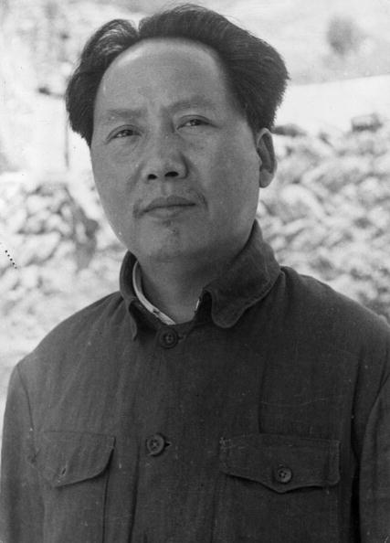
Mao built support by promising food to the starving population. Communist forces soon dominated.
Shek fled to Taiwan in 1949.
Mao took control of the mainland, renaming it the People’s Republic of China.

Slide 36
Mao’s victory deeply shocked Americans.
Communists seemed to be winning everywhere, extending their reach throughout the world.
Communist regimes now controlled
One fourth of the world’s landmass
One third of the world’s population
Containment is not working!!!!!

Slide 37
The Korean War

Slide 38
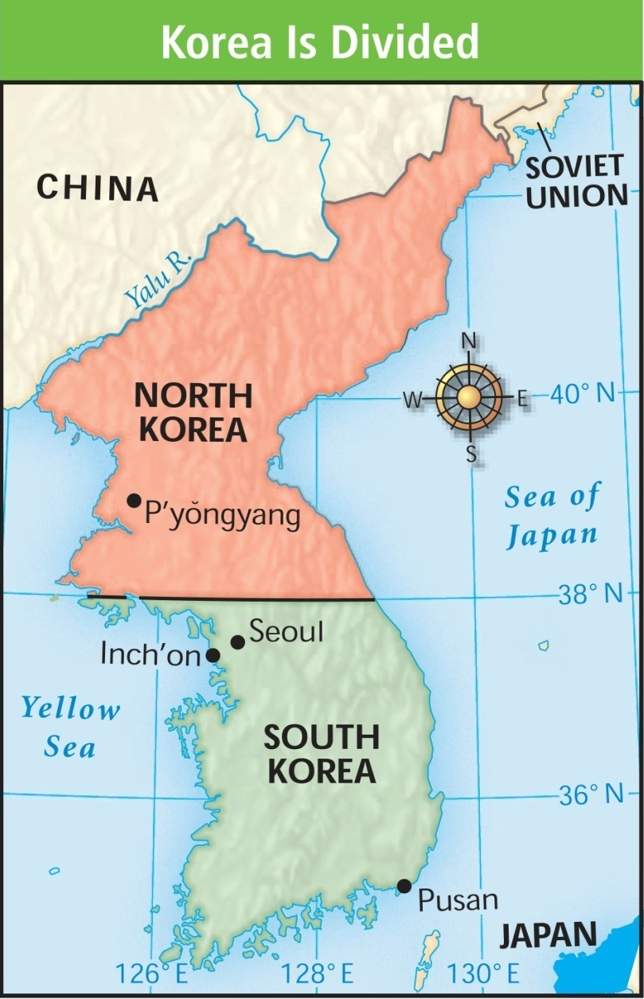
The next battleground was on the Korean peninsula.
Once controlled by Japan, Korea was divided along the 38th parallel into two countries after World War II.
1948 the Republic of Korea was formed in the South
Communist in the north formed the Democratic People’s Republic of Korea headed by Kim Il Sung.

Slide 39
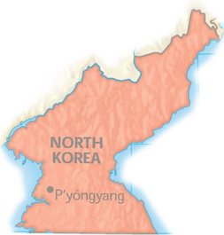
The Soviet Union supported North Korea and established a communist government there.
North Korea
The United States provided aid to noncommunist South Korea.
The US began to cut back its armed forces in South Korea in 1949.
By June 1949 there were only 500 US troops in the South
South Korea
Notes:
39

Slide 40
The Soviets concluded that the US would not defend South Korea.
Soviet Union began to back North Korea with tanks, planes, money, and weapons.
June 25, 1950, North Korean troops crossed the 38th Parallel.
North Korea quickly advanced deep into South Korea

Slide 41
South Korea called on the UN for help.
The Soviet Union was protesting the UN over the Chinese Nationalist being on Taiwan and were unable to veto the UN’s plan for military action.
June 27, President Truman ordered troops from Japan to South Korea.

Slide 42
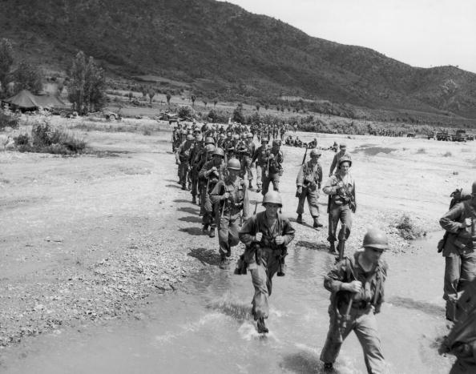
16 nationals sent 52,000 troops to aid South Korea
90% were American
590,000 South Korean troops.
All trooped were under the command of Douglas MacArthur

Slide 43
North Korea quickly captured Seoul (Capital) and forced the UN troops back to Pusan.

Slide 44
MacArthur launched a counterattack behind enemy lines at Inchon.
Other troops moved north from Pusan.
The massive counterattack forced about half of North Korean’s troops to surrendered and the rest fled back across the 38th parallel towards the Chinese border.

Slide 45
In November 1950, 300,000 Chinese troops crossed the border and drove the UN forces back.
Chinese 10 to 1 advantage.
Chinese captured Seoul.
War turned into a 2 year standoff

Slide 46
In 1951 MacArthur called for an invasion of China.
Nuke major Chinese cities
China and Soviet Union had a mutual-assistance pack with China.
World War III?
Instead of attacking China, UN forces battled to reclaim Seoul.

Slide 47
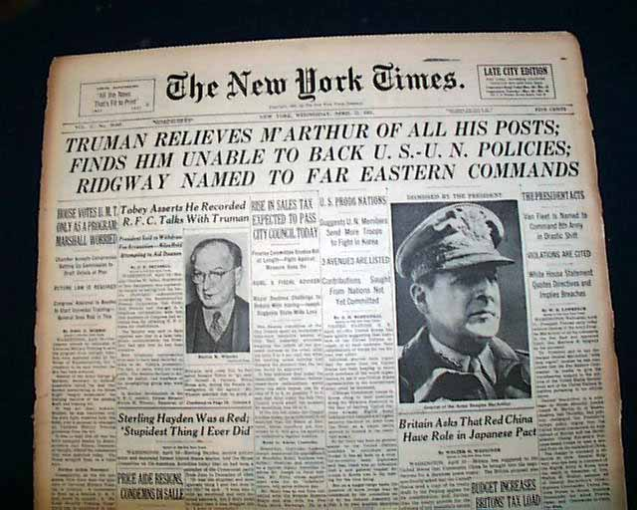
MacArthur still wanted to invade China.
He went to the papers and Republicans to gain support.
A fed up Truman finally fired MacArthur.

Slide 48
June 23, 1951 the Soviet Union suggested a cease fire.
July 1951 the two sides reached an agreement:
The location of the cease-fire at the existing battle line
the establishment of a demilitarized zone
July 1953 an armistice was officially signed.
War was stalemate
Communism was contained
No atomic weapons were used
54,000 American died
67 billion dollars
Democratic lost election in 1952 (IKE)
Fear of communism grows in the US

